Slide 1


Loan status prediction using IBM Watson Machine learning
TEAM-10
T. HARINI
V. ASHISH
T. SAI CHAND
T. RITHIK RAO
V. TEJASWI REDDY

Slide 2
Introduction
Loans are the core business of loan companies. The main profit comes directly from the loan’s interest.
The loan companies grant a loan after an intensive process of verification and validation. However, they still don’t have the assurance that the applicant will be able to repay the loan with no difficulties.
In this tutorial, build a predictive model to predict if an applicant is able to repay the lending company.
You’ll prepare the data using a Jupiter Notebook and then build the model using IBM SPSS Modeler.

Slide 3
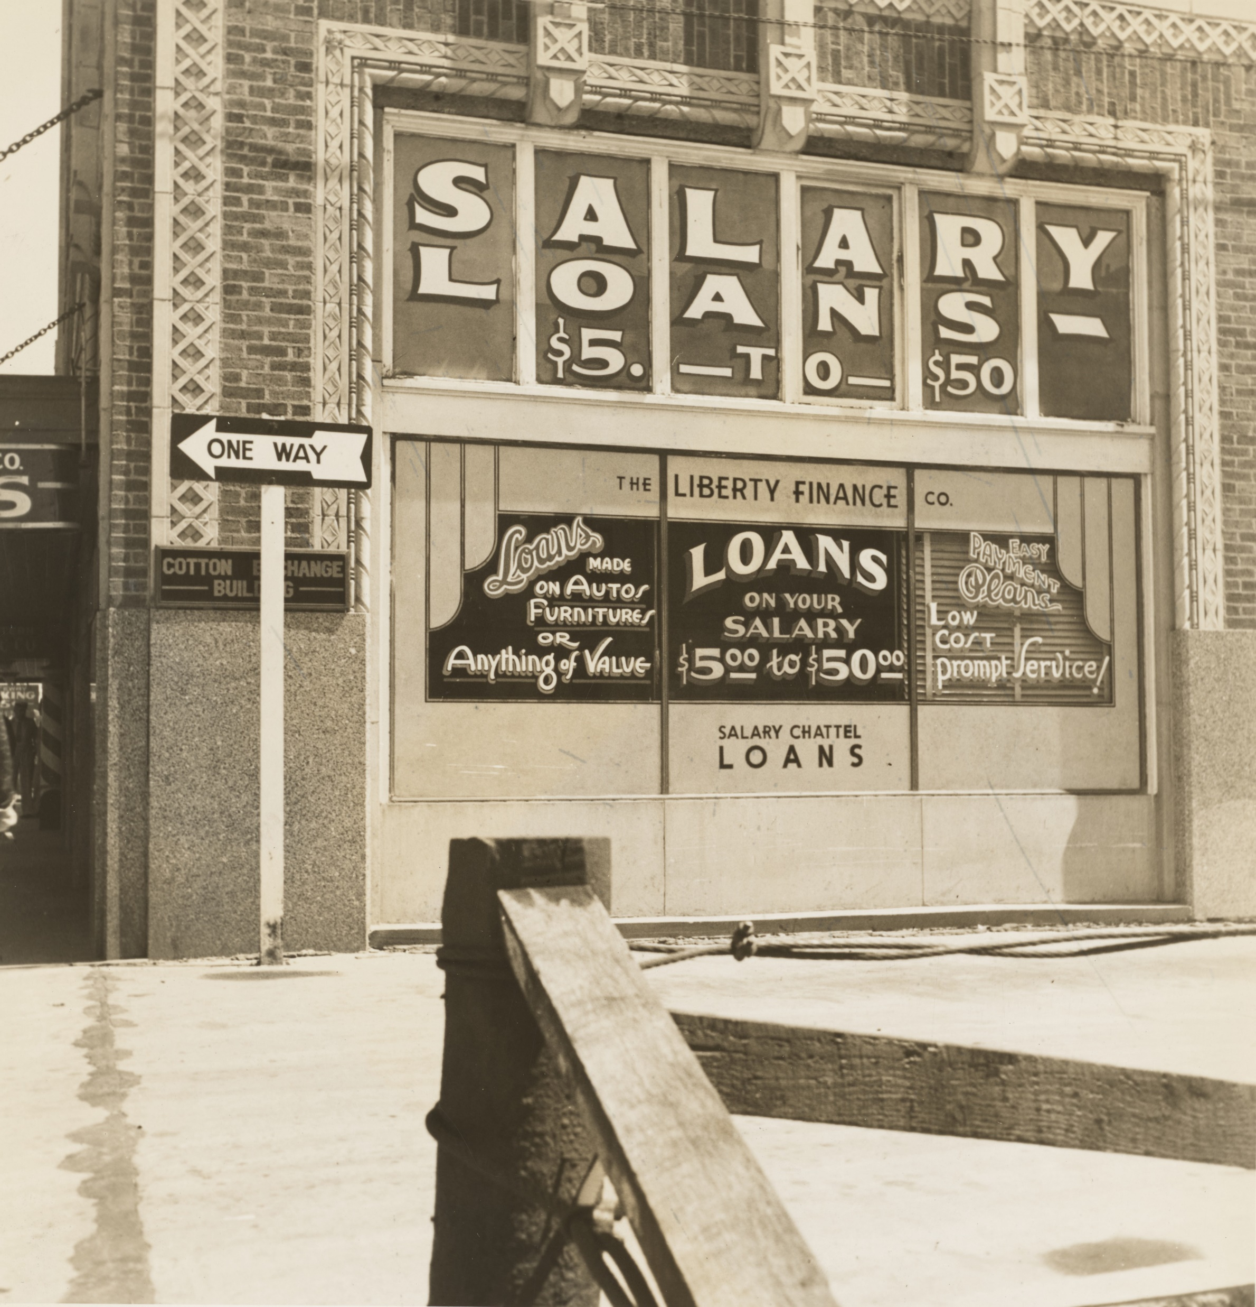
Bivariate Analysis
Applicants with high incomes should have more chances of loan approval.
Applicants who have repaid their previous debts should have higher chances of loan approval.
Loan approval should also depend on the loan amount. If the loan amount is less, the chances of loan approval should be high.
Lesser the amount to be paid monthly to repay the loan, the higher the chances of loan approval.

Slide 4
Steps
Step 1. Create a project in Watson Studio
Step 2. Upload the data set to Watson Studio
Step 3. Create the SPSS modeler flow
Step 4. Add and prepare data
Step 5. Configure variables type
Step 6. Build a machine learning model
Step 7. View the model
Step 8. Evaluate the performance of the model
Step 9. Save the model

Slide 5
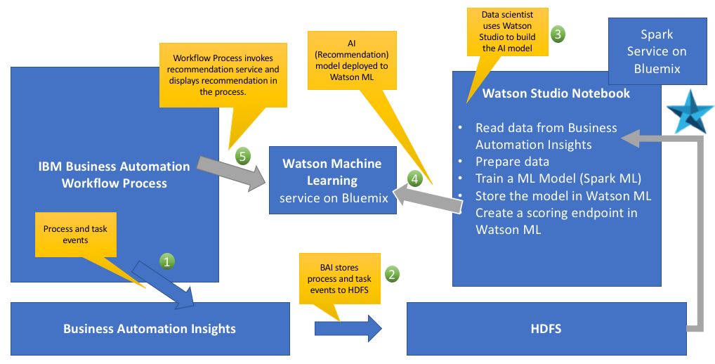

Slide 6
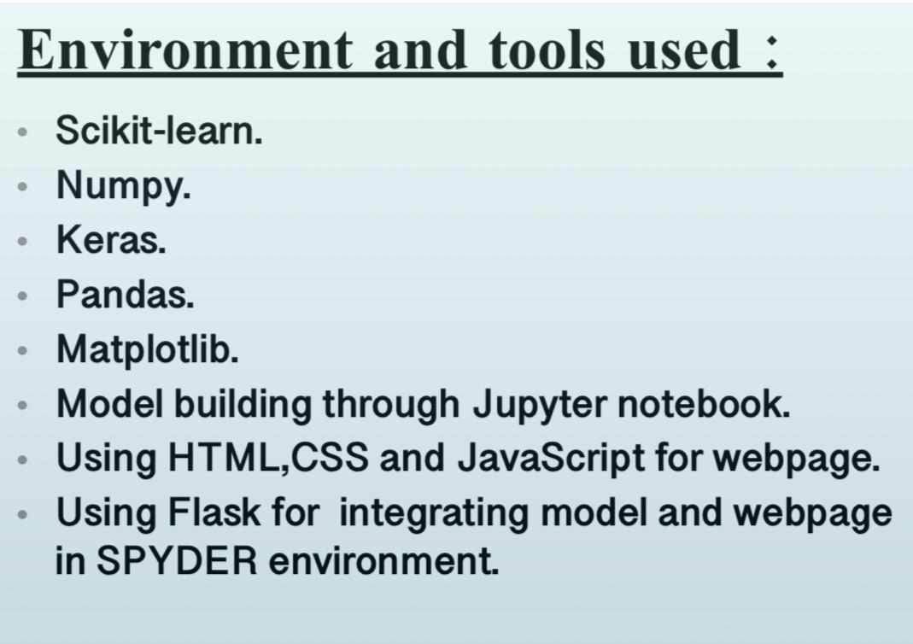

Slide 7
Loans are the core business of banks. The main profit comes directly from the loan's interest.
Loan companies grant a loan after an intensive process of verification and validation. However, they still don't know for sure if the applicant will be able to repay the loan with no difficulties.
Conclusion
This is a classification problem where we have to predict whether a loan will be approved or not. In a classification problem, we have to predict discrete values based on a given set of independent variable(s).
Loan prediction is a very common real-life problem that each retail bank faces at least once in its lifetime. If done correctly, it can save many hours of work.
Although this tutorial is specially built to give a walkthrough of a Loan Prediction problem, you can always refer the content to get a comprehensive overview to solve a classification problem.

